Slide 1
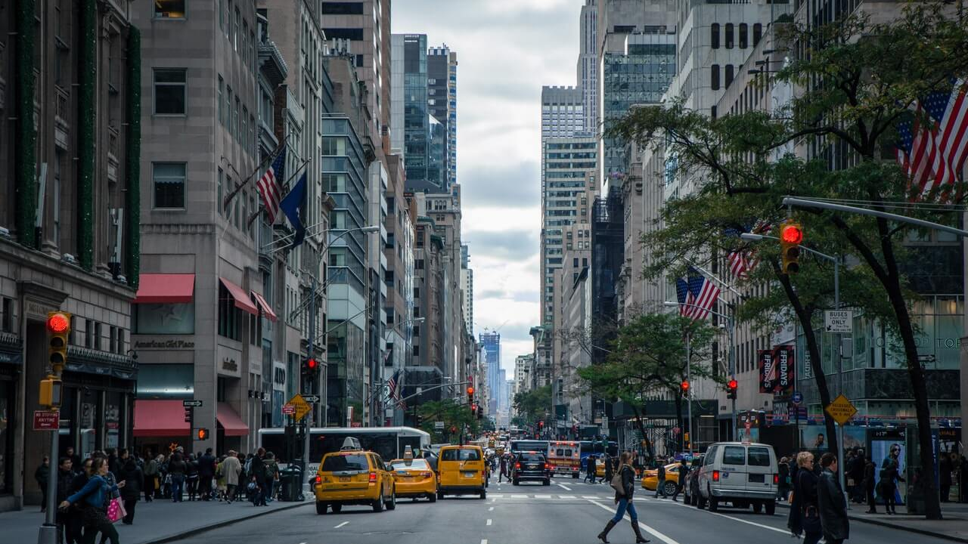
The effects of Social Inflation
By: Michael Vitale

Slide 2
Outline
Industry Impact
3rd Party Claims Funding
Social Inflation
Nuclear Verdicts

Slide 3
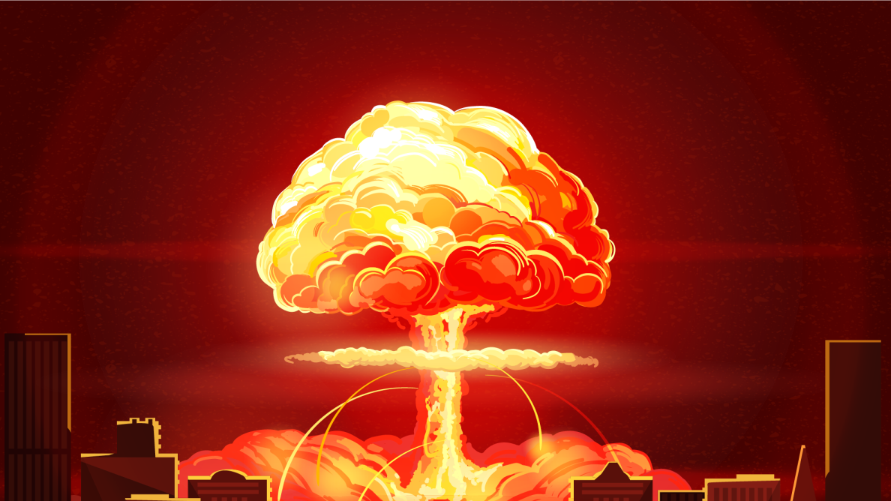
Nuclear Verdicts
McDonalds hot coffee
  $2.7 Million

Slide 4
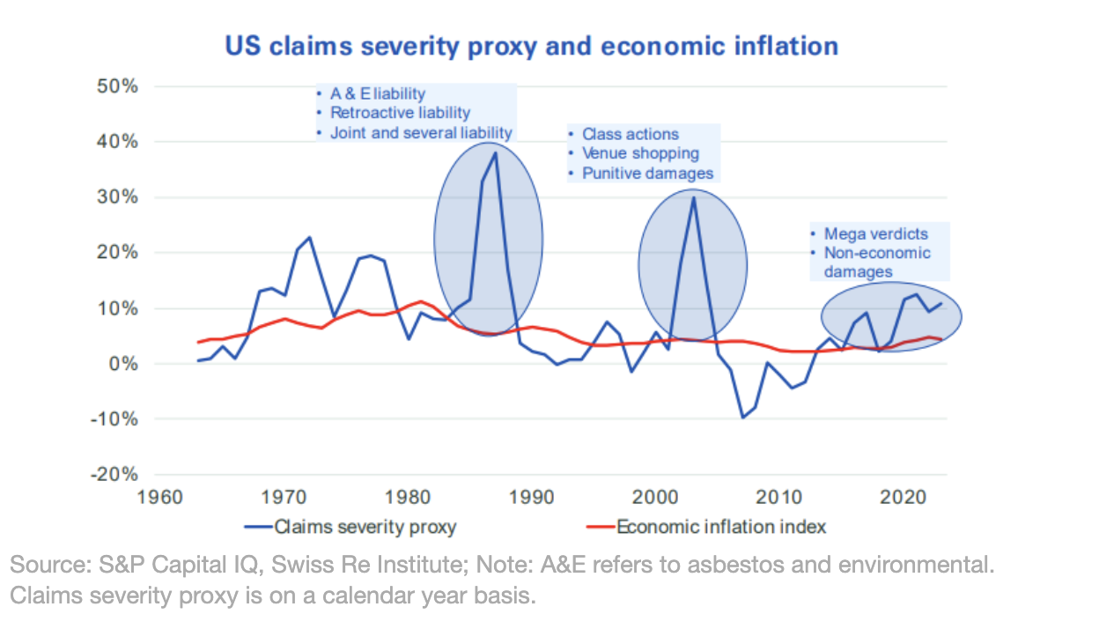
2023 - 27 Cases where awards surpassed 100 million – Insurance Journal

Slide 5

Social Inflation
Social Inflation, a societal shift in Juries attitudes towards corporations is the largest contributor to the “Nuclear Verdict” – Insurance Information Institute
Social Inflation has surpassed economic inflation as the primary driver of casualty claims – Insurance Journal
Social Inflation is driving an increase in loss severity in the commercial auto and product liability industries (20% despite inflation remaining 2-3%
Social Inflation: has added $30billion to commercial auto insurance costs, forcing increasing premiums and reduced coverage– CAS

Slide 6
Social Inflation has created a market for
3rd Party Claim Funding
Third Party Litigation Funding (TPLF)
Increasing Contingency Fees
Without transparency or direct ties to litigated cases, institutional investors contribute significant amounts of capital toward litigation suits for profit.
Insured claimants receive smaller portions of settlements as attorneys and funders profit even more.
Plaintiff Attorney Advertising
Eroding Caps on Damages
  Settlements and case damage awards increased by 27.5% from 2010 to 2019, largely due to limited or no caps on damages in the U.S. judicial system.
Through erosion of judicial standards, plaintiff attorneys spend billions on advertising,

Slide 7
Industry Impacts of Social Inflation
Decrease Profitability of Insurance Industry
Nuclear Verdicts have severely impacted the Industry’s financial stability
Without tort reform or TPLF regulation, the insurance industry faces severe challenges
Raised Costs for Consumers
Insurers are responding by raising rates, tightening policy terms and reducing coverage to manage risk
Ex: Trucking industry– premiums as high as 11% due to rate hikes

Slide 8
References:
"McDonald’s Hot Coffee Case 30 Years Later: Revisiting the Original ‘Nuclear Verdict.’" Tyson & Mendes, 12 Apr. 2023, www.tysonmendes.com/mcdonalds-hot-coffee-case-30-years-later-revisiting-the-original-nuclear-verdict/.
“Social Inflation Contributed $30B Increase in Commercial Auto Costs, Paper Finds.” Casualty Actuarial Society, 7 Nov. 2022, www.casact.org/article/social-inflation-contributed-30b-increase-commercial-auto-costs-paper-finds.
"Social Inflation: Hard to Measure, Important to Understand." Insurance Information Institute, www.iii.org/article/social-inflation-hard-to-measure-important-to-understand.
"What Can We Do About Social Inflation?" Insurance Information Institute, www.iii.org/article/what-can-we-do-about-social-inflation.
"Viewpoint: Insurers, Insureds Must Collaborate to Get Ahead of Social Inflation." Insurance Journal, March 14, 2024, www.proquest.com/docview/2956751165/7C506DC324EA40D3PQ/6.
"Social Inflation Key Factor in Rise of Loss Severity: AM Best." Insurance Journal, June 3, 2024, www.proquest.com/docview/3063544027/7C506DC324EA40D3PQ/10.
"US Nuclear Verdicts Break Records and Drive Social Inflation to 7% in 2023: Report." Insurance Journal, 11 Sept. 2024, www.insurancejournal.com/news/international/2024/09/11/792372.htm.
"6 Ways the Claims Industry Can Mitigate Social Inflation." EY, www.ey.com/en_us/insights/insurance/6-ways-claims-industry-can-mitigate-social-inflation.
"What’s Driving Accelerating Social Inflation?" Insurance Business Magazine, www.insurancebusinessmag.com/us/news/reinsurance/whats-driving-accelerating-social-inflation-504965.aspx.

