Slide 1


WSB
December 2025
NVIDIA Buy Recomendation
By: Michael Vitale

Slide 2
OVERVIEW
Part 1
Part 2
Part 3
Part 4
Part 5
Business Description
Tension Points
Investment Thesis
Valuation
Risks

Slide 3
Investment Overview
Recommendation: | Buy with a 12–24 month horizon
Target Price: | ~$238–239 vs. current ~$182
Framework: | Scenario-weighted target using P/E and EV/EBITDA, cross-checked with a short-dated DCF
Upside: | ~31% upside
Key message: AI infrastructure is a multi-year program, not a one-off bubble; NVIDIA is the choke point with a full-stack moat

Slide 4
NVIDIA End Markets
% of Rev.
Data Centers
89%
AI accelerators, systems, networking, and software; NVIDIA’s economic engine
Gaming & Professional Visualization
10%
GeForce GPUs and RTX platform, plus workstations/creative workloads
~1%
Automotive
ADAS and autonomous driving platforms (Drive)
<.5%
OEM & Other
Legacy and smaller businesses
Notes:
NVIDIA today is overwhelmingly an AI data center company.
Roughly 89% of revenue comes from Data Center, which includes AI accelerators, systems, networking, and software; gaming is about 10%, with Automotive and OEM each low single digits.
So the rest of this presentation is really about the AI infrastructure business, not legacy gaming GPUs.

Slide 5
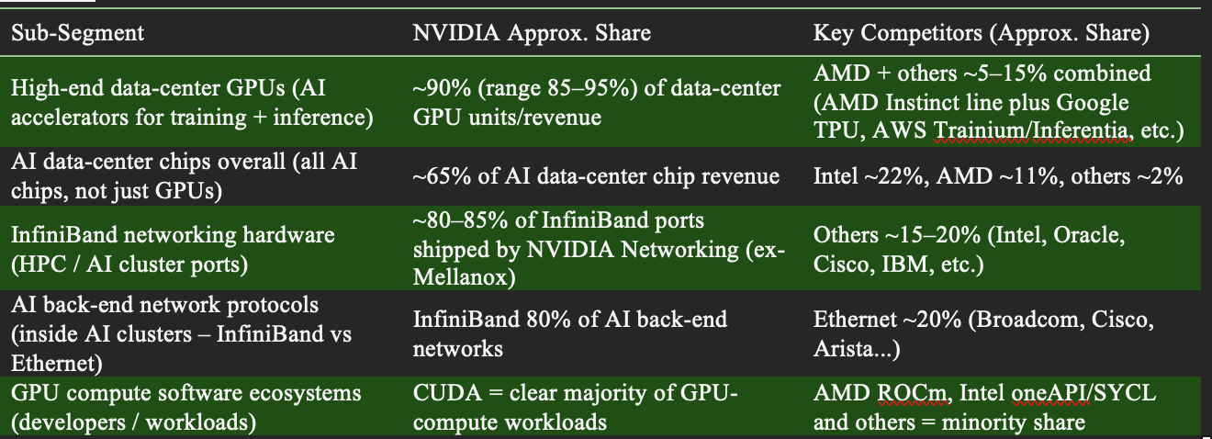
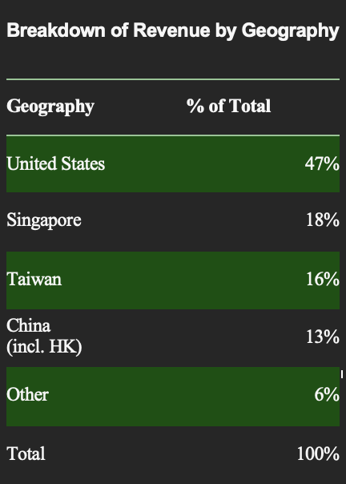
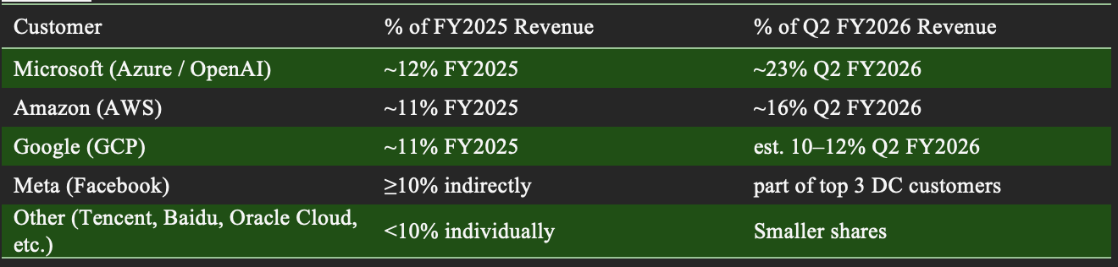
Economic/Competitive Environment
Notes:
On the competitive side, NVIDIA has roughly 90% share of high-end data-center GPUs, about 65% of AI data-center chip revenue overall, and around 80–85% of InfiniBand networking ports.
Most of that revenue is concentrated in a small set of ‘AI factory’ customers—Microsoft, Amazon, Google, and Meta—but no single customer is more than about 20–25% of revenue.
Key competitors are AMD and in-house accelerators at the hyperscalers, plus traditional networking and semi vendors.

Slide 6
DEFENSIBLE MOAT
Full-stack platform
• NVIDIA controls GPUs, systems, networking, and CUDA/software, not just chips.
• Tight integration across the stack delivers better time-to-train and time-to-deploy than piecemeal alternatives.
CUDA & software ecosystem
• CUDA and NVIDIA’s libraries/frameworks are deeply embedded in AI workflows.
• Engineers emphasized high switching costs and “integration pain” in moving off CUDA or supporting multiple stacks.
Networking & systems
• NVIDIA’s InfiniBand + NVLink + reference rack designs give it an edge at the rack/cluster level, not just at the chip.
Result: I treat NVIDIA as an AI infrastructure platform with a durable moat, which supports premium margins and slower-than-feared share erosion.
Notes:
The reason this hasn’t commoditized yet is the full stack.
NVIDIA controls chips, systems, networking, and CUDA/software, and customers highlighted how much the integration and tooling matter.
CUDA is deeply embedded, and several engineers described high switching costs and ‘integration pain’ in moving off CUDA or running multiple stacks.
I treat NVIDIA as an AI infrastructure platform with a durable moat, which supports premium margins and slower-than-feared share erosion.

Slide 7
Tension Points of the Business
Supply Chain – HBM & CoWoS
Hyperscaler AI Capex & Buyer Power
Whether HBM and advanced packaging stay a hard cap on data-center growth or ease enough to unlock another leg of upside; faster ramps at SK hynix, Samsung, Micron, and TSMC would mean more Blackwell systems and a richer margin mix than the market models today.
If a handful of “AI factory” customers (MSFT, AMZN, GOOGL, META) keep AI capex structurally high or move into a sharper digestion as custom silicon and buyer power grow; my field work points to an elevated but lumpy, stair-step pattern rather than a near-term cliff.
Power Availability & Cooling
Competition & Policy
Whether power, grid, and liquid-cooling bottlenecks become a structural cap on AI build-outs or mainly push projects out by a few quarters; I treat power/cooling as phasing risk that adds volatility, not permanent demand destruction, over my 18–24 month horizon.
How quickly AMD and custom cloud chips can erode NVIDIA’s share and pricing, and whether export controls/AI policy simply reshape NVIDIA’s mix or materially cap TAM and margins; I view alternatives as taking pocket share while CUDA and full-stack integration keep a premium footprint, with regulation as a key asymmetric downside risk.
Notes:
Before the thesis, it’s worth flagging where the stock is actually debated.
First, HBM and CoWoS: do they stay a hard cap on shipments, or ease enough to unlock another leg of upside?
Second, hyperscaler AI capex and buyer power: are we looking at a sustained AI program, or a sharper digestion as custom silicon ramps?
Third, power and cooling: do grid and thermal constraints become a structural limit, or mainly push projects out by a few quarters?
And finally, competition and policy: how fast can AMD and in-house chips erode share and pricing, and do export controls just reshape the mix, or really cap TAM and margins?

Slide 8
Investment Thesis
Durable AI infrastructure
2) Full-stack Moat supports premium economics
AI infrastructure demand is a multi-year program, not a one-off spike; I underwrite a longer, bumpier AI infra cycle with digestion periods but no hard cliff.
CUDA, software, systems, and networking give NVIDIA a defensible, full-stack platform, driving structurally high gross, EBIT, and FCF margins even as competitors ramp.
Traditional Investments
High liquidity and strictly regulated by institutions. Examples include stocks, bonds, and mutual funds.
3) Bottlenecks stretch, rather than kill, the cycle
4) Second wave of enterprise/vertical demand
HBM/CoWoS and power/cooling are real constraints, but they mainly shift revenue to later years instead of destroying the 5-year cash-flow opportunity.
A second wave of enterprise and industry-specific demand (healthcare, finance, industrials) builds behind hyperscalers, helping backfill digestion and sustain growth.
Notes:
I organize the thesis into four parts:
(1) AI infrastructure demand is durable and multi-year.
(2) NVIDIA’s full-stack moat supports premium economics even as competition ramps.
(3) Bottlenecks stretch the cycle rather than kill it—they move revenue right, but don’t destroy the five-year cash-flow opportunity.
(4) A second wave of enterprise and vertical demand builds behind the hyperscalers and helps backfill any digestion.

Slide 9
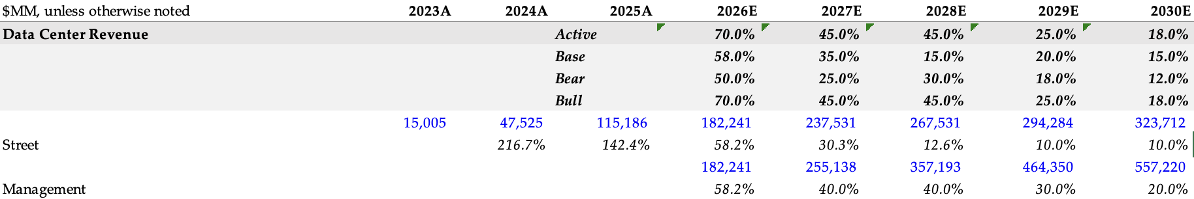
Thesis 1: Durable AI Infrastructure Cycle
Cycle shape
Street is torn between an “AI super-cycle” and a bubble that peaks then busts. I underwrite a longer, bumpier AI infra cycle—with digestion periods, but no hard cliff—based on what customers told me about multi-year build plans and follow-on orders.
Evidence from field work
High conversion from pilots to production once use cases prove ROI.
Follow-on orders that are often larger than the initial deployment.
Roadmaps framed over 3–5+ years, not one-year experiments.
Notes:
On cycle shape, Street views split between an ‘AI super-cycle’ and a bubble that peaks then busts.
Based on my field work, I underwrite a longer, bumpier AI infra cycle—we get digestion periods, but no hard cliff.
Customers described high conversion from pilots into production once use cases prove ROI, and follow-on orders that are often larger than the initial cluster.
Roadmaps are framed over 3–5+ years, not one-year experiments.
In the model, that shows up as Data Center revenue growing from roughly $130B to about $400B by the end of the forecast, with growth slowing but never collapsing

Slide 10
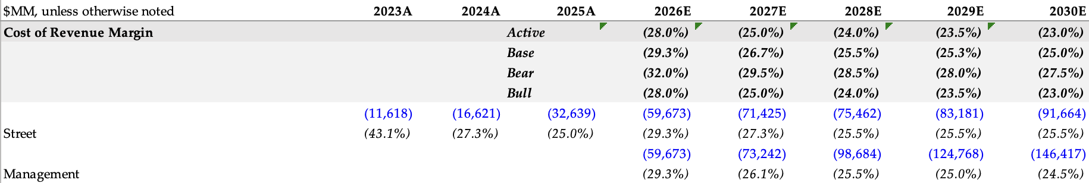
Thesis 2: Full-Stack Moat & Premium Margins
Moat & competition
Many models assume fast share loss and margin compression as AMD/custom ASICs ramp. I assume modest share loss but sustained premium margins, because of what users told me about CUDA, integration pain, and networking lock-in.
Field feedback
CUDA and NVIDIA’s software stack are deeply integrated into production workflows.
Teams see NVIDIA systems + networking as the “safe default” for mission-critical AI.
Notes:
Second, I assume modest share loss but sustained premium margins, which is more optimistic than many models.
A lot of consensus work bakes in fast share loss and margin compression as AMD and custom ASICs ramp.
What I heard instead was that CUDA and NVIDIA’s software stack are deeply integrated into production workflows, and teams see NVIDIA systems plus networking as the ‘safe default’ for mission-critical AI.
Porting off that stack is expensive and risky, so customers will tolerate a price premium.
In the numbers, that means gross margins in the low-70s and EBIT margins in the high-50s to low-60s, with FCF margins around 50% in my base and bull cases.

Slide 11
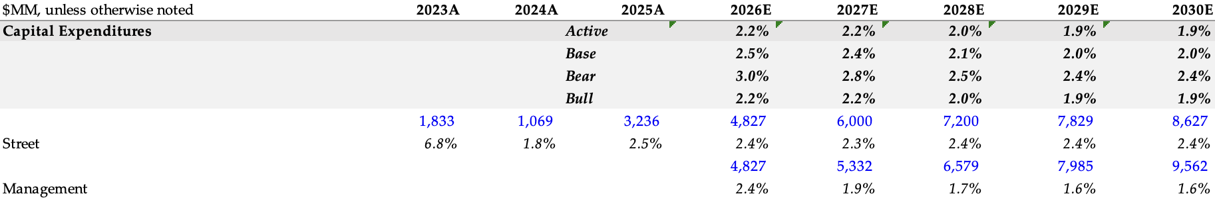
Thesis 3: Bottlenecks Stretch the Cycle
Constraints
Many models treat HBM/packaging and power as cap-exhaustion risks. I mostly treat them as timing risks that stretch revenue into later years.
Field feedback
Data-center planners framed GPUs, HBM, packaging and power/cooling as gates in the queue, not reasons to cancel projects.
Projects are often reprioritized or delayed by a few quarters, but the multi-year AI roadmap remains intact.
Notes:
Third, I treat HBM/packaging and power as timing risks, not cap-exhaustion.
Data-center planners I spoke with framed GPUs, HBM, CoWoS, and power/cooling as gates in a queue, not reasons to cancel projects.
Projects are reprioritized or delayed by a few quarters, but the multi-year AI roadmap remains intact.
That’s why my capex as a percent of sales sits around 2–3%—NVIDIA is fabless—and why I’m comfortable using a slightly higher terminal growth rate than a mature semi in the DCF.
In practice, bottlenecks shift revenue to later years, but don’t meaningfully shrink the five-year cash-flow pie.

Slide 12
Thesis 4: Second Wave of Enterprise/Vertical Demand
Demand mix
Street focus is still heavily on the hyperscaler AI “arms race.” I give more weight to the second wave of enterprise/vertical demand (healthcare, finance, industrials), which is early but showing up in my calls.
Field feedback
Enterprises are moving from lab pilots to production workflows (claims, risk, R&D, back-office automation).
Many plan hybrid or on-prem deployments for data-sensitive workloads, where NVIDIA captures most of the stack.
** Represented in increased revenue projections shown in Thesis 1
Notes:
Finally, the second wave of demand.
Street focus is still heavily on the hyperscaler AI ‘arms race’, but surveys and my calls suggest a growing enterprise and vertical pipeline—healthcare, finance, industrials.
Many of those customers are just starting AI programs with small clusters and specific use cases, but plan multi-phase rollouts if early projects work.
I give that more weight than consensus in the out years, which is why Data Center remains roughly ~90% of total revenue and continues to grow even after a hyperscaler digestion.

Slide 13
Valuation
I started with my key drivers, anchored in field research and the core debates around the cycle. My field work points to an AI buildout that’s elevated but lumpy and a longer, bumpier AI infra cycle with digestion periods but no hard cliff, rather than a one-off spike.
I then pulled those drivers through my operating model to translate my view on cycle shape, supply/power gating, and competitive dynamics into base/bear/bull financial outcomes. Consistent with my thesis, I treat HBM/packaging and power/cooling primarily as timing risks that stretch revenue into later years, not as permanent demand destruction.
Finally, I converted the operating model outputs into valuation using a scenario-weighted P/E and EV/EBITDA, cross-checked with a short-dated DCF. Because I treat NVIDIA as the choke point with a full-stack moat, I believe premium economics can persist even as alternatives scale. This framework supports a Buy with a 12–24 month horizon and a ~$238–239 target vs. ~$182 (~31% upside).
1
2
3
Notes:
to value the business, I started with those drivers—cycle shape, moat, and bottlenecks—translated them into a base, bear, and bull operating model, and then into valuation.
Consistent with my thesis, I treat supply and power as phasing risks, not permanent demand destruction.
I then apply P/E and EV/EBITDA multiples to the out-year earnings and cross-check the result with a short-dated DCF.

Slide 14
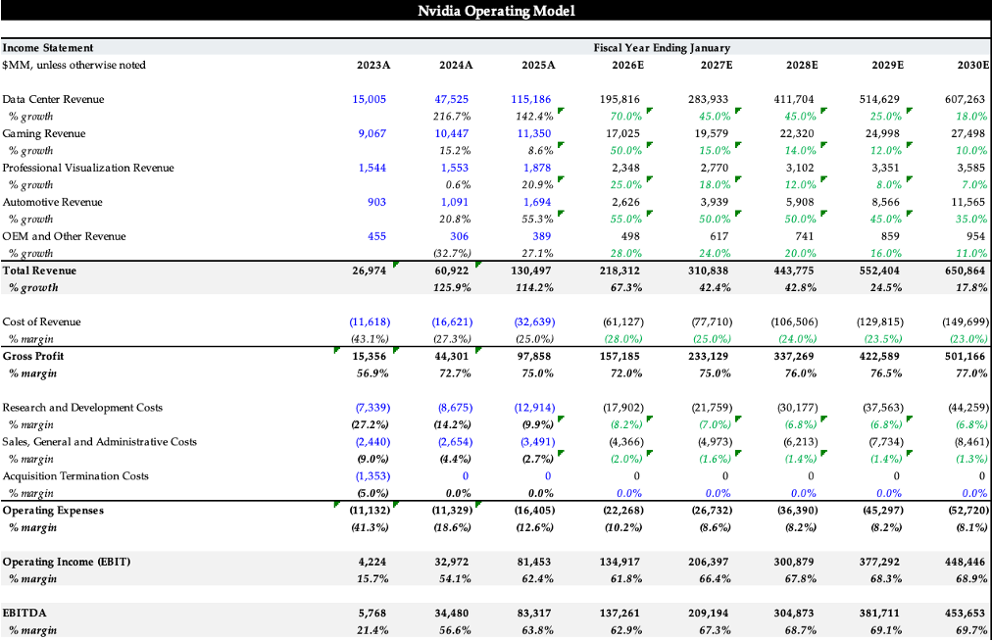
Notes:
Here’s the operating model at a high level.
Total revenue grows from about $131B to roughly $651B over the forecast, driven by Data Center.
Gross margins stay in the low-70s, and EBIT margins step up into the 60s as the AI stack scales, which flows through to very strong free cash flow.

Slide 15
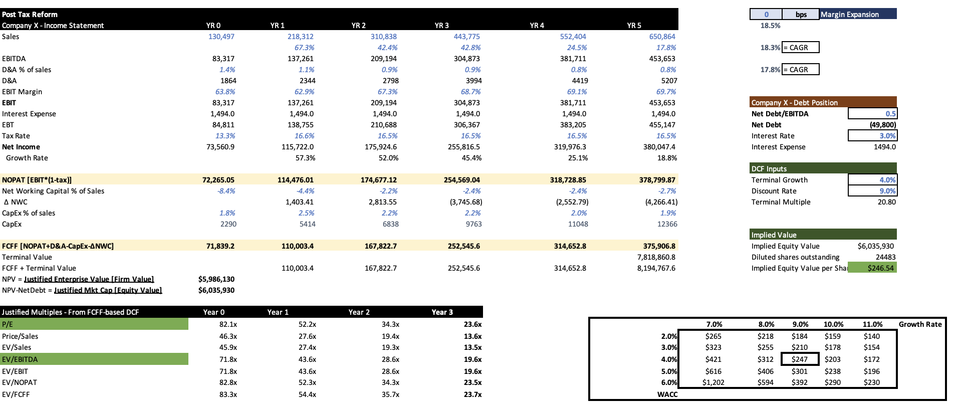
Note: I use a short-dated DCF as a sanity check on the multiples output.
Note: The DCF is directionally consistent with my scenario view and helps avoid over-relying on terminal assumptions.
Notes:
The DCF is a sanity check, not the primary driver.
I use a ~9% discount rate and a 4% terminal growth rate, which reflect my view that AI infrastructure behaves more like a long-lived build-out plus platform fees than a peaked PC cycle.
The DCF output is directionally consistent with my multiples-based target, which gives me confidence I’m not just hostage to one set of terminal assumptions.

Slide 16
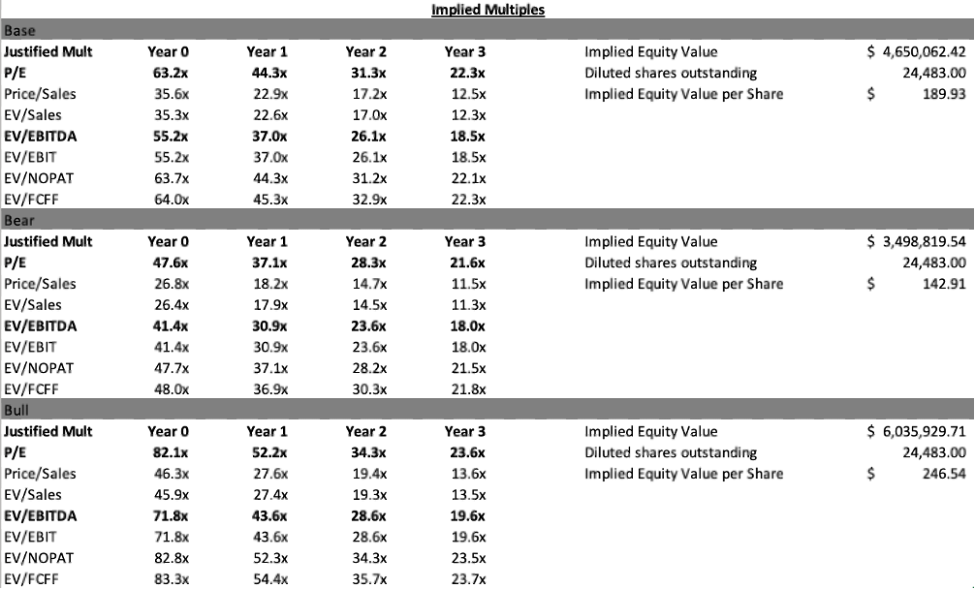
Base: modest share loss, sustained premium margins due to CUDA + systems/networking lock-in.
Bear: faster AMD/custom ASIC penetration and/or policy/supply pressure compresses growth/multiples.
Bull: easing supply and gating unlocks another leg of upside.
Notes:
This table shows the base, bear, and bull cases.
In the base, I assume modest share loss but sustained premium margins; in the bear, faster AMD and custom ASIC penetration or policy/supply pressure compresses growth and multiples; in the bull, easing supply and gating unlocks another leg of upside.
The implied prices are roughly $190 in base, $143 in bear, and $247 in bull, and my scenario-weighted target of about $238 is quite close to the bull, reflecting my conviction in the extended cycle view.

Slide 17
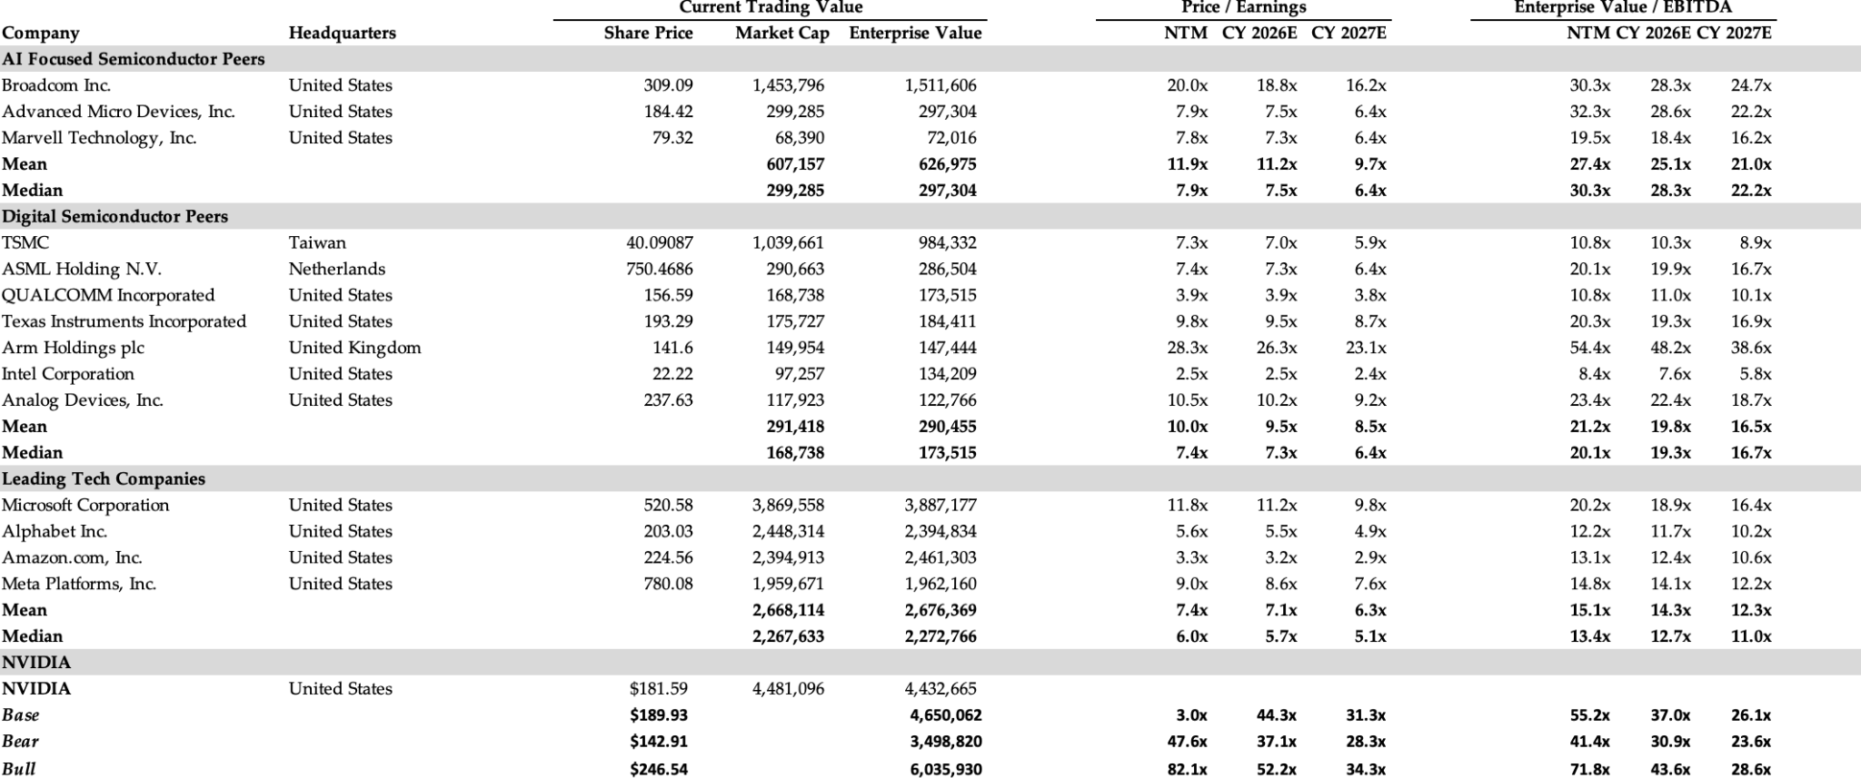
Note: NVIDIA deserves a premium footprint as the full-stack choke point (GPUs, systems, networking, CUDA/software).
Note: My view assumes slower-than-feared share erosion versus consensus because of integration pain and ecosystem depth.
Notes:
On a relative basis, I compare NVIDIA to AI-focused semis, broader digital semis, and leading tech platforms.
Given its growth, margins, and strategic role as the full-stack choke point, I think NVIDIA deserves a premium multiple—but not an arbitrary one.
The target multiples I use are a premium to peers, but grounded in where high-quality growth stories have traded historically.

Slide 18
Key Risks
1) Export controls & China exposure
Tighter U.S. rules could limit high-end GPU sales to China or force lower-ASP compliant mix, trimming a meaningful slice of bull-case upside.
Monitor: NVIDIA China mix/commentary and U.S. policy updates.
2) Supply chain shocks – HBM, CoWoS, substrates
HBM or CoWoS bottlenecks could delay Blackwell ramps and turn “phasing risk” into a 1–2 year growth/valuation timing hit.
Monitor: SK hynix/Samsung/Micron/TSMC capacity, CoWoS yields/lead times.
3) Power & grid constraints
Power/cooling shortages could push AI data-center buildouts beyond my 18–24 month horizon, pressuring near-term revenue/FCF vs. base.
Monitor: Interconnect queues, permitting, hyperscaler power updates.
4) Competition & buyer power
Greater AMD and hyperscaler ASIC penetration could compress pricing/share and pull premium multiples down.
Monitor: Hyperscaler accelerator mix signals and AMD DC momentum.
Notes:
The main risks are:
(1) Export controls and China—tighter U.S. rules could limit high-end GPU sales or force lower-ASP compliant parts, trimming a meaningful slice of bull-case upside.
(2) Supply-chain shocks to HBM, CoWoS, or substrates—those could turn ‘phasing risk’ into a real 1–2 year hit to growth and my 12–24 month target.
(3) Power and grid constraints—if power and cooling shortages push AI factories beyond my horizon, near-term revenue and FCF could undershoot.
(4) Competition and buyer power—faster AMD or in-house adoption could compress pricing and drag the multiple down.
I’m actively watching NVIDIA’s China mix and commentary, HBM/CoWoS capacity, power/permit updates, and hyperscaler accelerator mix to see if we’re drifting toward my bear case.

Slide 19
Questions?

